Slide 1
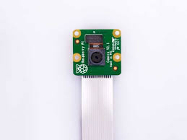
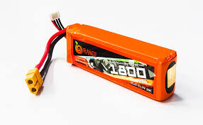
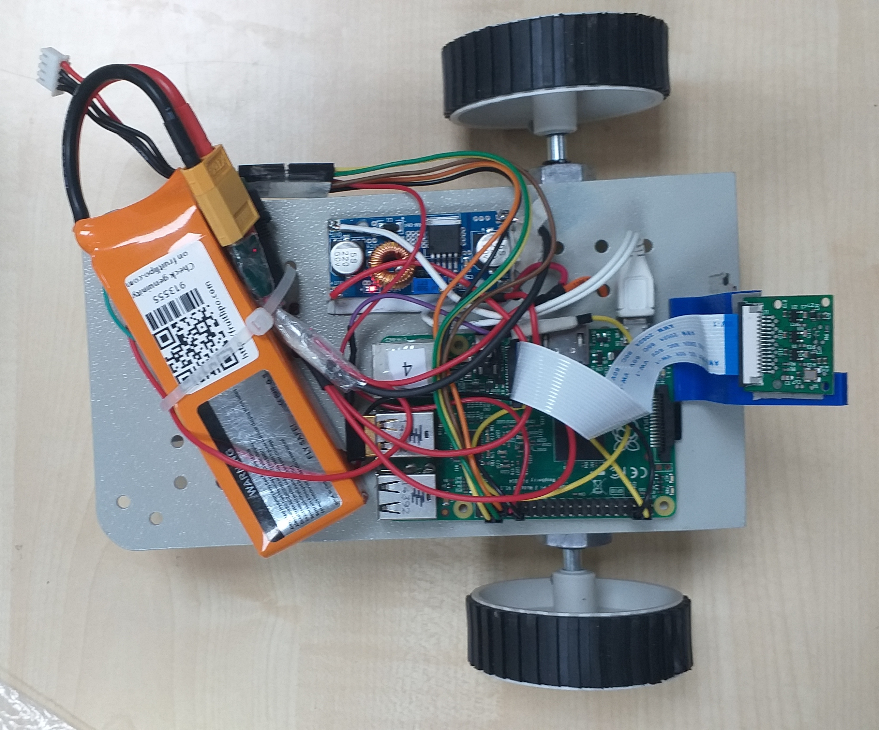
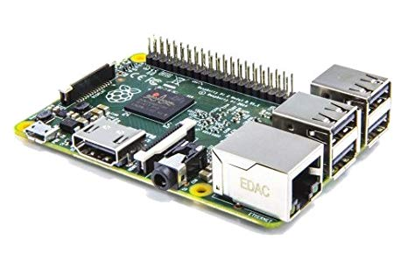
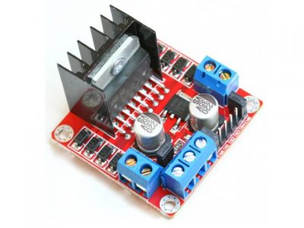
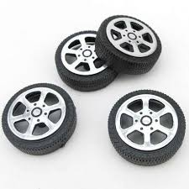
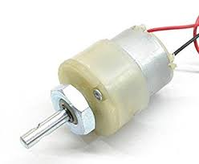
Hardware Components:
Raspberry pi cam
Li-Po Battery
Raspberry pi 2
Wheels
Motor Control
DC motor

Slide 2
Phase 1
Dataset collection for training the Neural Network Model for the Bot.
Bot (V 2.0) (Autonomous Bot)

Slide 3
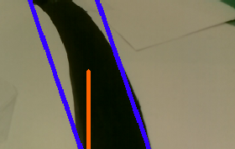
Dataset Collection:
The bot was running with PID controllers, uses a control loop feedback mechanism to control navigation of the bot along the track.
It draws a contour around the lane and finds the angle between the line (always pointing to 0 degree) for each frame.
Captures that frame and record the angle.
Example:
Dataset collected at the rate of 19fps.
Total Size: 0.9GB
Contains image of dimension (184x320)
1582 Images and steering angles. (5-6 min)

Slide 4
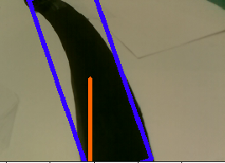
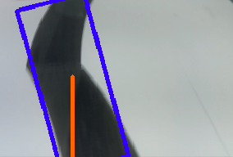
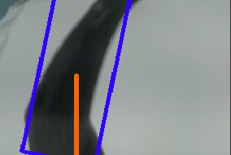
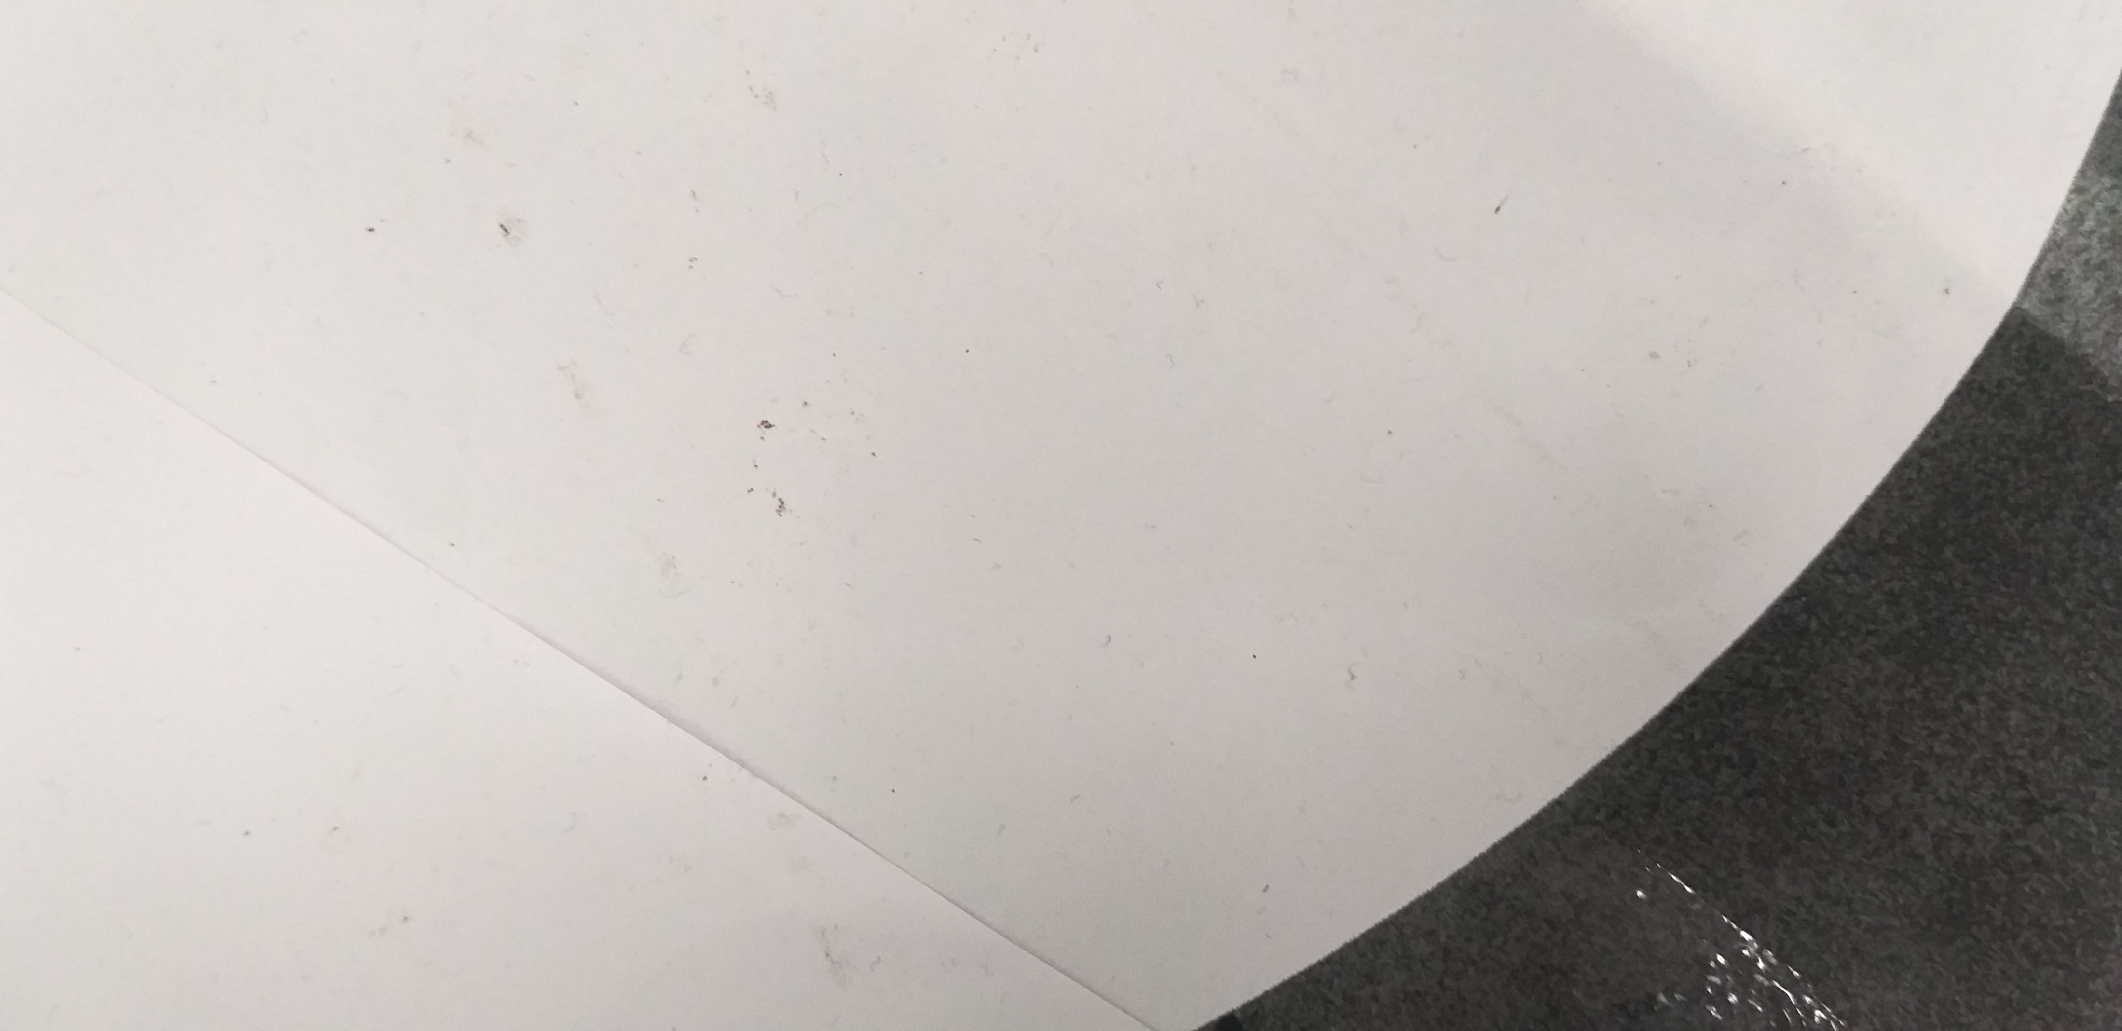
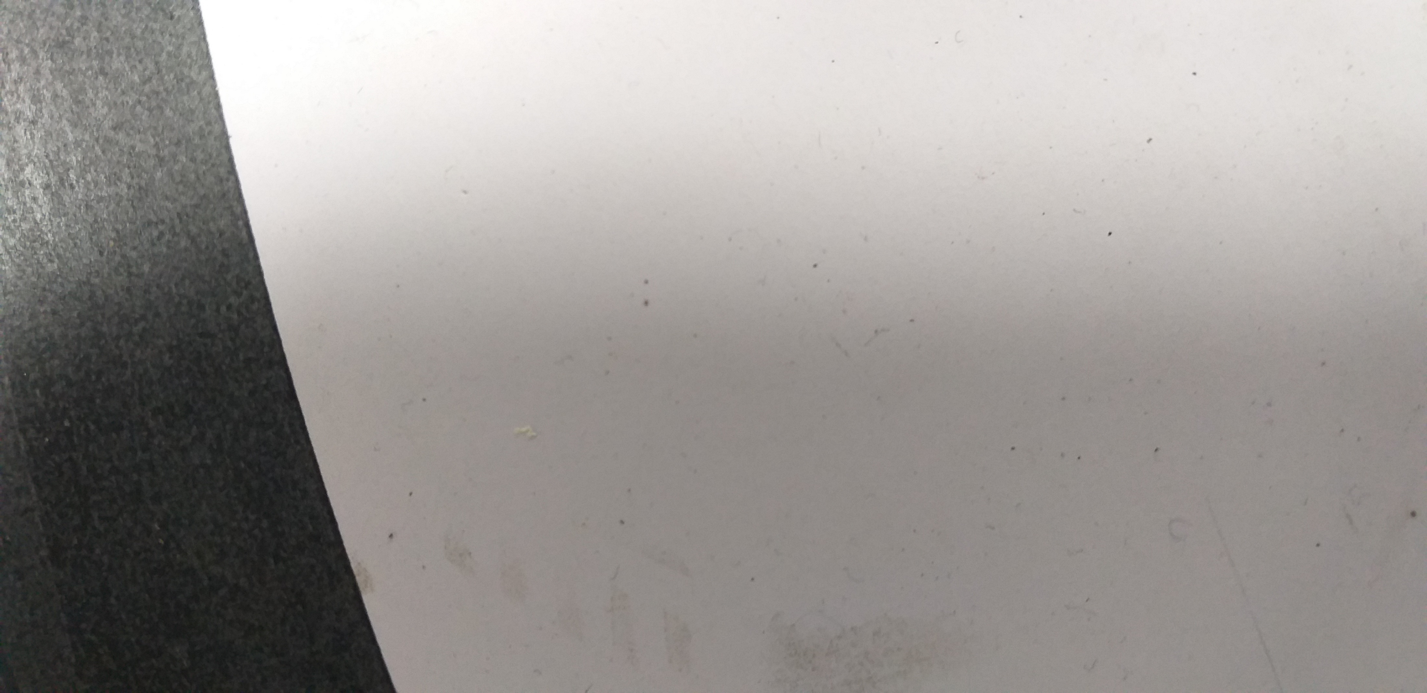
Dataset samples:
Frames
Steering angle
-13.522
-14.001
12.699
40.699
30.699

Slide 5
Phase 2
Training Neural Network model for the Bot which will predict the up-next angle.

Slide 6
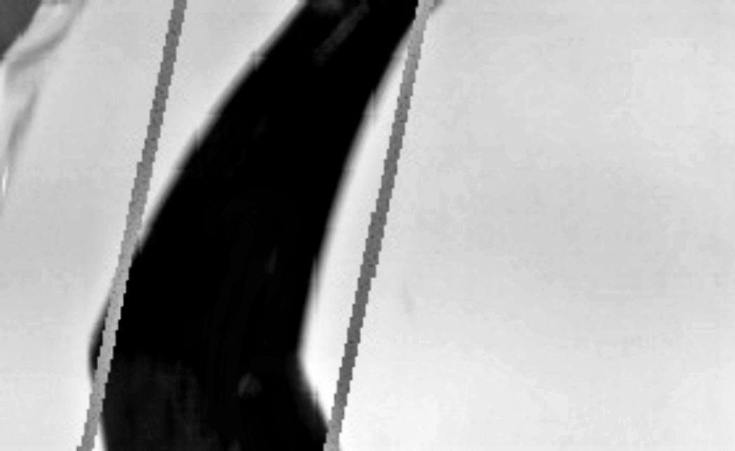
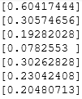
Step 1. Data Pre-processing
Scaling the steering angle.
The steering angles are scaled between 0-1.
Sample scaled values:
Grey-scaling coloured (BGR) image and normalizing pixel values.
(pixel value = pixel value /255)
BGR
Gray

Slide 7
Step 2. Training Neural network Model
CNN model
-Calculate the
angle difference/loss (Mean Squared)
-Adjust the weights.
-Back proportion
Steering
Angle
Image (184x320)

Slide 8
Some hit and trails for making good CNN architecture:
Convolution layers | Maxpool layer | Dense layer | Dropouts | No. of epochs | Activation function | Optimizer | Weight initialization | Train Loss | Test Loss
4 (5x5) | 2 (2x2) | 3 | 0 | 100 | relu | adam | random | 2.0271 | 2.9987
8 (5x5) | 2 (2x2) | 3 | 0 | 100 | relu | adam | random | 1.2071 | 1.3044
8 (5x5) | 2(2x2) | 3 | 2 | 100 | relu | adam | He_normal | 0.0014 | 0.0019
8 (5x5) | 2(2x2) | 3 | 2 | 100 | relu | adam | random | 0.0028 | 0.0017
8(5x5) | 2(2x2) | 3 | 0 | 100 | relu | sgd | He_normal | 0.0464 | 0.0482
8(5x5) | 2(2x2) | 3 | 0 | 100 | relu | RMSProp | random | 0.0036 | 0.00297
8(5x5) | 2(2x2) | 3 | 0 | 100 | relu | RMSProp | He_normal | 0.0031 | 0.00351
8(5x5) | 2(2x2) | 3 | 0 | 25 | tanh | adam | He_normal | 0.000006 | 0.0025
8(5x5) | 2(2x2) | 3 | 0 | 25 | sigmoid | sgd | random | 8.3559 | 8.1224

Slide 9
Phase 3
Node detection

Slide 10
Mnist model Dataset:
Mnist model was trained with 70000 images
Train set:
30000: Original images
30000: Vertically flipped images
Test set:
5000: Original images
5000: Vertically and horizontally flipped images
Train accuracy: 98.7%
Test accuracy: 98.8%

Slide 11


Mnist model
The Mnist model is trained on all the original images as well as augmented (Vertically flipped) images.
By assigning distinct number to each node, we can identify the location of the bot.
L.2 & L.3 Rectified

Slide 12
Phase 4
Powering motors

Slide 13
Defining ratios to power motors according to the angle predicted:
Step1: Calculating number of rotations of a motor taking 90 degree turn.
Step2: Calculating the angle associated to each degree of rotation.
Step3: Getting power ratio
power = speed*100 (Full power 90 degree rotation)
power = (motor_error *Steering_angle + Steering_angle*1.1 )*Speed

Slide 14
Key challenges:
Getting good precisions in dataset.
Dataset is not similar to any of pretrained CNN models hence transfer learning is not of much use, new CNN architecture is designed.
Very slow computation in Pi 2, the number of frame it can process is 10-11 approx. This impacts adversely on the bot’s performance.
With the current camera, the vision of the bot is restricted to very small range. So, probability to convergence back to track when turn is very sharp becomes less.
To divide power to the DC motors without in very accurate ratio according to the angle predicted by the Neural Network Model.
The number of rotations for a certain degree changes with speed supplied to the motor, there is no feedback mechanism with current type of motor used.

Slide 15
Thank You
Your suggestions are valuable….

